Slide 1




NEXT GEN EMPLOYABILITY PROGRAM
Creating a future-ready workforce
Team Members
College Name
Student Name : LOGESHWARI.V
Student ID : au510421104053
Arunai engineering college ,
Tiruvannamalai

Slide 2

CAPSTONE PROJECT SHOWCASE
Project Title
Building Bus Reservation System using Python and Django
Abstract | Problem Statement | Project Overview | Proposed Solution | Technology Used | Modelling & Results | Conclusion

Slide 3
Abstract
The Bus Reservation System (BRS) is an integral component of modern transportation management, aimed at facilitating seamless travel experiences for passengers while optimizing operational efficiency for service providers. This abstract presents an overview of the key functionalities and benefits of the proposed BRS.
BRS is designed to offer a user-friendly interface for both passengers and administrators, enabling easy booking, modification, and cancellation of bus tickets. Through an intuitive online platform and mobile application, passengers can search for available routes, select preferred seats, and make secure payments, thereby eliminating the need for physical ticketing counters and reducing queuing times.
Additionally, the BRS provides comprehensive reporting and analytics functionalities for administrators, offering insights into booking trends, occupancy rates, and revenue generation. By leveraging data-driven decision-making, operators can adjust pricing strategies, allocate resources effectively, and enhance overall operational performance.
Source :Google,Youtube and ChatGPT

Slide 4
Problem Statement
Complex Booking Process: Existing bus reservation systems often feature convoluted booking processes, leading to user frustration and decreased conversion rates. Users may encounter difficulties in searching for available routes, selecting preferred departure times, and making secure payments. Simplifying and optimizing the booking process is essential to improve user experience and increase customer satisfaction.
Lack of Real-time Information: Many bus travelers face challenges in accessing up-to-date information on seat availability, route schedules, and fare details. Without real-time updates, passengers may encounter discrepancies between online bookings and actual seat availability, leading to inconvenience and dissatisfaction. Integrating real-time information updates into the reservation system is crucial for providing accurate and reliable booking services.
Administrative Burden: Bus operators often struggle with manual and time-consuming administrative tasks, including route management, inventory tracking, and customer support. Traditional methods of managing bookings and schedules may be prone to errors and inefficiencies, hindering operational performance and scalability. Developing an intuitive administrative interface with automated management capabilities can alleviate the administrative burden and enhance operational efficiency for bus operators.
Source :Google Scholar-Market research and analysis of existing bus reservation systems and their shortcomings.

Slide 5
Project Overview
The project aims to develop a modern, scalable, and user-friendly bus reservation system to address the inefficiencies present in traditional bus booking processes. By leveraging the power of Python programming language and Django web framework, the system will offer a streamlined booking experience for passengers while enhancing operational efficiency for bus operators.
To develop a user-centric bus reservation system that enhances the booking experience for passengers.
To improve operational efficiency for bus operators through automated management tools and real-time updates.
To create a scalable and extensible system capable of accommodating future enhancements and growing user demands.
Source: Google Scholar-Market research and analysis of existing bus reservation systems and their shortcomings

Slide 6
Proposed Solution
User-friendly Booking Interface: The system will feature an intuitive and easy-to-use booking interface, allowing passengers to search for available routes, select preferred departure times, choose seats, and make secure payments seamlessly.
Real-time Updates: Integration of real-time information updates on seat availability, route schedules, and fare details to provide accurate and reliable booking services for passengers. This ensures that the information presented to users is always up-to-date.
Administrative Dashboard: Development of an intuitive administrative dashboard equipped with automated management tools for route planning, inventory tracking, and customer support. This dashboard will empower bus operators to efficiently manage bookings and operations.
Scalability and Extensibility: Designing the system with scalability and extensibility in mind to accommodate future enhancements, third-party integrations, and growing user demands. This ensures that the system can adapt and grow alongside the evolving needs of the bus transportation industry.
Source: Google Scholar-Market research and analysis of existing bus reservation systems and their shortcomings

Slide 7
Project Deliverables:
The project deliverables of a Bus Reservation System (BRS) typically include a range of components and outputs that collectively contribute to the successful development, deployment, and operation of the system. Here are the key deliverables:
System Requirements Documentation
System Design Documentation
User Interface Prototypes
Database Schema
Booking System
Admin Panel
Bus Tracking and Management Features
Testing and Quality Assurance
Maintenance and Support Plan
Project Documentation and Closure
Source : Google Scholar-Market research and analysis of existing bus reservation systems and their shortcomings

Slide 8


Technology Used
Front-end
Back-end

Slide 9
Modelling & Results
In the development of the bus reservation system using Python and Django, various modeling techniques and methodologies will be employed to design and implement the system's architecture, data structures, and user interfaces. Additionally, rigorous testing and evaluation processes will be conducted to ensure the system meets the specified requirements and delivers the desired outcomes.
1. System Architecture:
The system architecture will be designed to ensure scalability, reliability, and performance. It will include components such as:
Frontend: Developed using HTML/CSS/JavaScript and Django templates for user interfaces.
Backend: Implemented using Python and Django framework to handle business logic, data processing, and interaction with the database.
Database: Utilizing a relational database management system (e.g., PostgreSQL) to store data related to routes, bookings, users, and other system entities.
APIs: Building RESTful APIs using Django REST Framework to facilitate communication between frontend and backend components.
2. Data Modeling:
Entity-Relationship Diagrams (ERDs) will be used to model the relationships between different entities in the system, such as users, buses, routes, and bookings. This will ensure that the database schema is well-structured and optimized for efficient data retrieval and manipulation.

Slide 10
3. User Interfaces:
User interface mockups and wireframes will be created to design the layout, navigation flow, and visual elements of the system. These mockups will then be translated into functional frontend components using HTML, CSS, JavaScript, and Django templates.
4. Implementation:
The system will be implemented according to the proposed architecture and design specifications. Python and Django will be used to develop the backend logic, while frontend components will be built using HTML/CSS/JavaScript and Django templates. Database interactions will be managed using Django's ORM (Object-Relational Mapping) to ensure data integrity and consistency.
5. Testing and Evaluation:
A comprehensive testing strategy will be employed to validate the functionality, usability, and performance of the system. This will include unit testing, integration testing, and user acceptance testing to identify and address any issues or bugs. User feedback and usability testing will also be conducted to gather insights and make iterative improvements to the system.
6. Results:
Upon completion of the development and testing phases, the bus reservation system will be deployed to a web server for production use. Key performance metrics such as system uptime, response time, and user satisfaction will be monitored to evaluate the system's effectiveness in meeting its goals.
Overall, the modeling and results of the bus reservation system project will demonstrate the successful implementation of a modern and efficient booking platform, providing users with a seamless and enjoyable experience while optimizing operational processes for bus operators.

Slide 11
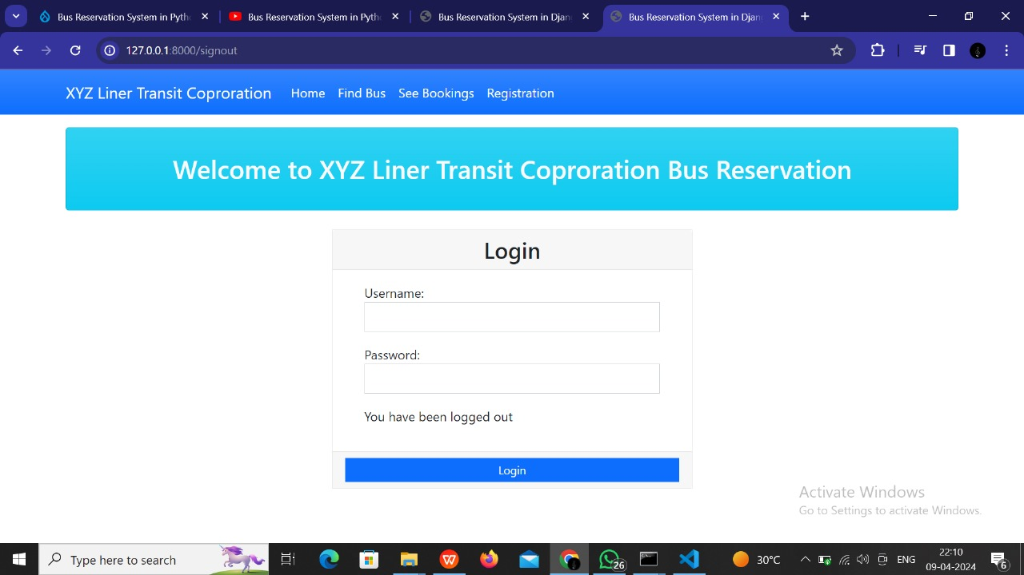
Homepage

Slide 12
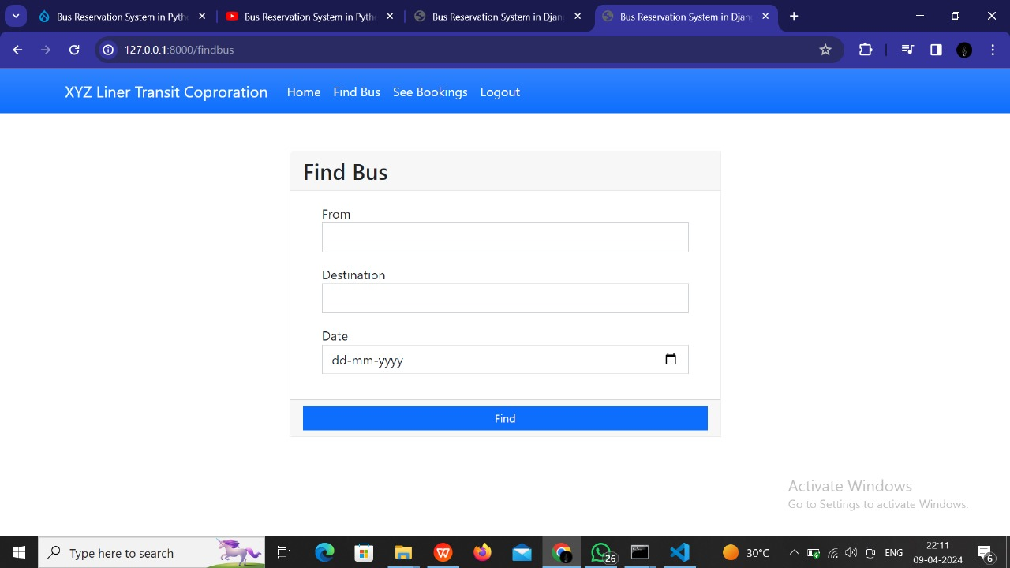
Finding the bus-Page

Slide 13
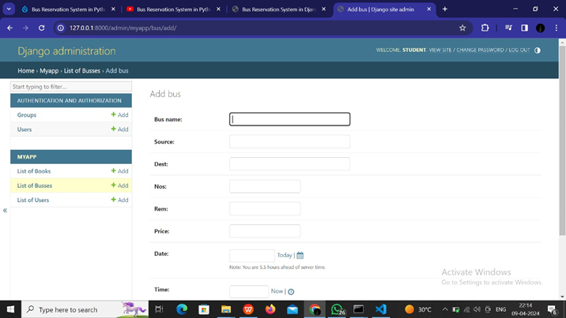
Service page

Slide 14
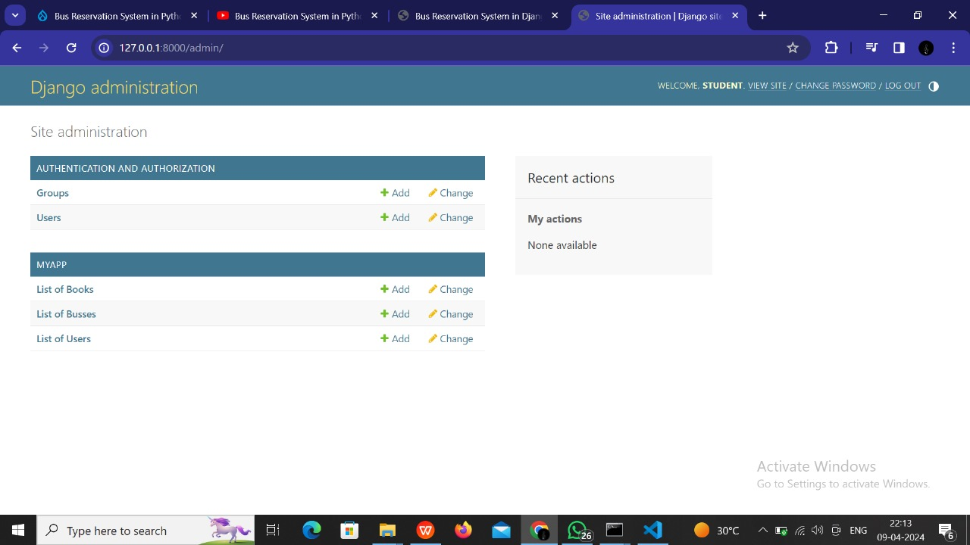
Department page

Slide 15
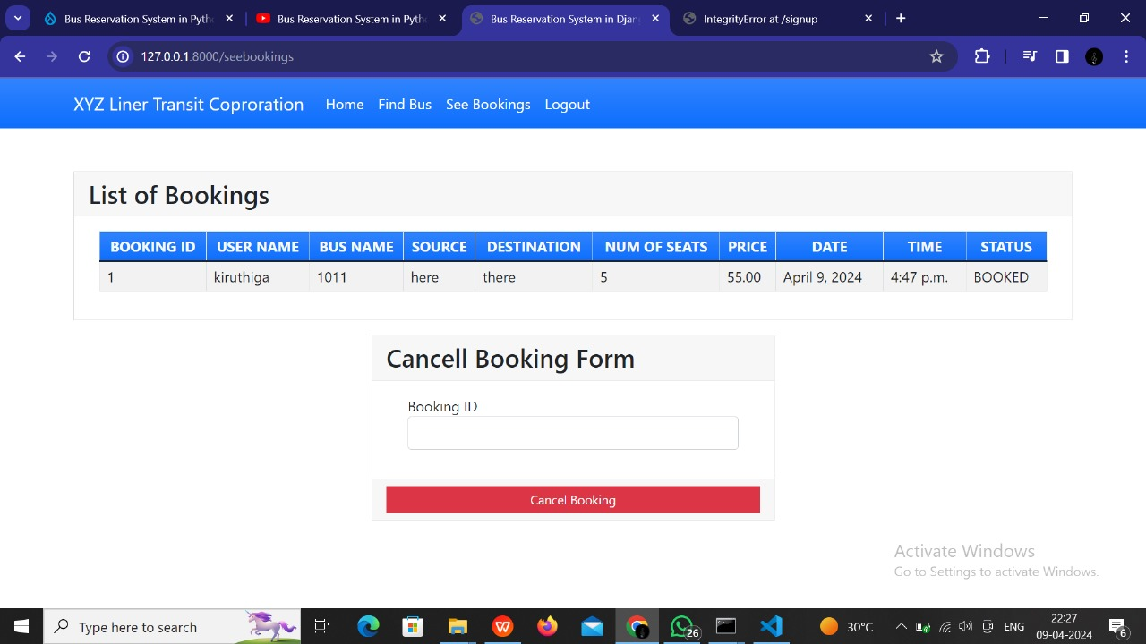
Service page (modification)

Slide 16
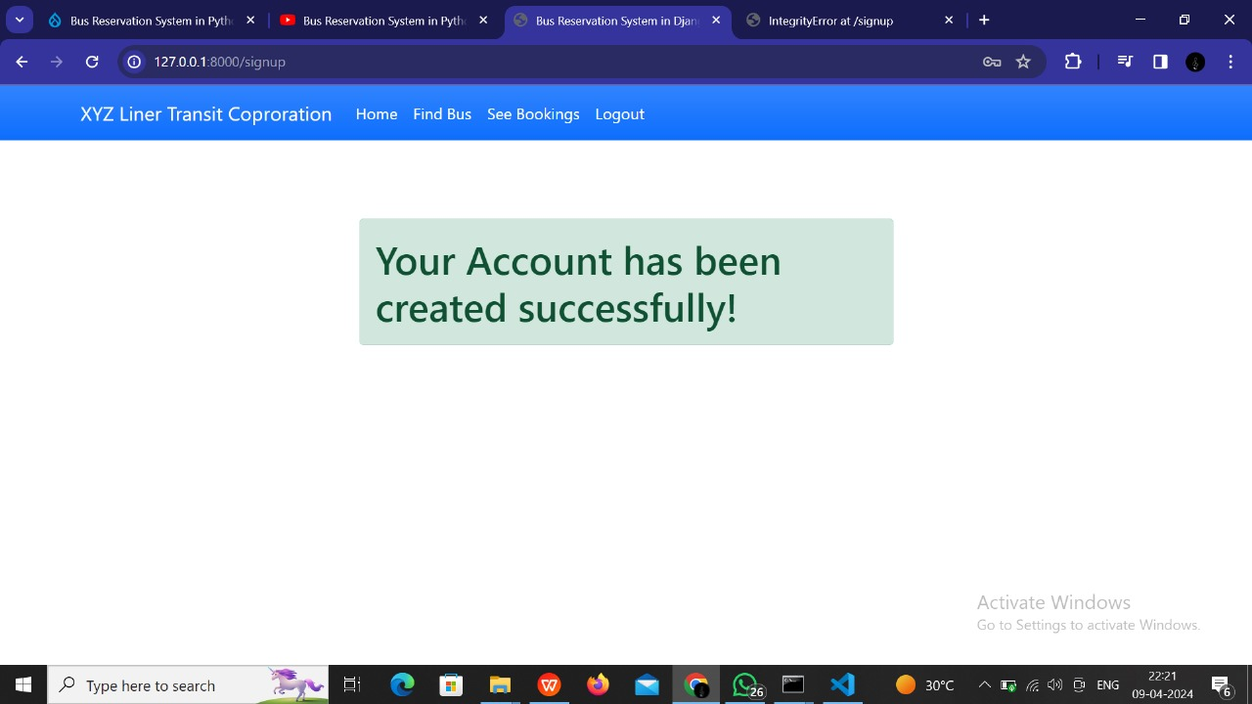
Account created and bus is reserved

Slide 17
Future Enhancements:
While the initial development of the bus reservation system will focus on meeting the core requirements and delivering a functional solution, there are several potential future enhancements that can further improve the system's functionality, user experience, and efficiency. These enhancements can be implemented iteratively based on user feedback, emerging technologies, and evolving business needs. Some possible future enhancements include:
Mobile Application Development
Blockchain Integration for Security and Transparency
Personalized Recommendations
Accessibility Features
Virtual Reality (VR) Seat Selection
Voice-Activated Booking and Customer Support

Slide 18
Conclusion
In conclusion, the Bus Reservation System represents a significant advancement in the management of bus transportation, offering enhanced convenience for passengers and improved operational efficiency for service providers. Through its innovative features and user-centric design, the BRS aims to revolutionize the way bus travel is managed and experienced, ultimately contributing to a more sustainable and connected transportation ecosystem.

Slide 19
Thank You!
Notes:
Thank You !!

